Slide 1


6TH GLOBAL ISLAMIC FINANCE FORUM
NOVEMBER 2016, NAIROBI - KENYA
BY
Joof Momodou Musa
MANAGING DIRECTOR/CEO
ISLAMIC INSURANCE(TAKAFUL)/MICRO TAKAFUL GROWTH POTENTIALS IN AFRICA
JAIZ TAKAFUL INSURANCE PLC

Slide 2

TOPICS
Introduction
What is Takaful
Operationalizing Takaful
Takaful Management Responsibility
Takaful Regulatory Framework
Differences : Conventional Insurance & Takaful
Takaful & Economy
Micro Takaful Definition
The Operation of Micro Takaful
Successful Developments
The Way Forward

Slide 3
What is Takaful
“a scheme based on brotherhood, solidarity and mutual assistance which provides for mutual financial aid and assistance to the participants in case of need whereby the participants mutually agree to contribute for that purpose.”
As defined in Section 2 Takaful Act 1984: (Malaysia)

Slide 4
OPERATIONALISING TAKAFUL
With A Two-tier Contract (Tabarru’ & Commercial)
Contract between the Participants themselves
Contract between Participants & TO.
Takaful Operator
Participant
Participant
Wakalah (contract for managing the fund)
Takaful Funds
General
Family
Participant
OR
Participant
Mudharabah (profit sharing) contracts
Participant
OR
Tabarru’ Contract
Any other commercial contract not forbidden by the Shariah.

Slide 5
Management Responsibility
The Shareholders Interest
The Participants
The Economy
Management’s Tripartite Responsibility

Slide 6
Takaful Regulatory Framework
Government Supervisory
Board of Directors
Sharia Advisory Board
Takaful Operations

Slide 7
Difference Between Takaful and Insurance
Conventional Insurance
Takaful Insurance
Ownership
by Shareholders
by Participants
Risk
Transfer to Insurers
Shared by Participants
Belongs to Shareholders / Company
Belongs to Participants
Surplus
Surplus
Surplus
by Shareholders
by Participants
Shariah S.Board
None
MUST

Slide 8
Differences…(continued)
Gharar
Gharar
Maisir
Maisir
Riba
Riba
Takaful
→ Tabarru’ filters out all the objectionable elements from the insurance contract.
→ Takaful = Insurance Minus The Objectionable Elements

Slide 9
Takaful & Economy
Employment
  Creation of Employment opportunities
Tax Revenue
  More Tax Revenue from the Insurance Industry

Slide 10
Takaful & Economy…
Comprehensive Risk Insurance
  Insuring the uninsured insurable risk
Increased Economic Activity
  Successful Economies are backed by vibrant Insurance industries
  Increased Investment with more participants in Insurance
  More confidence for new economic ventures

Slide 11
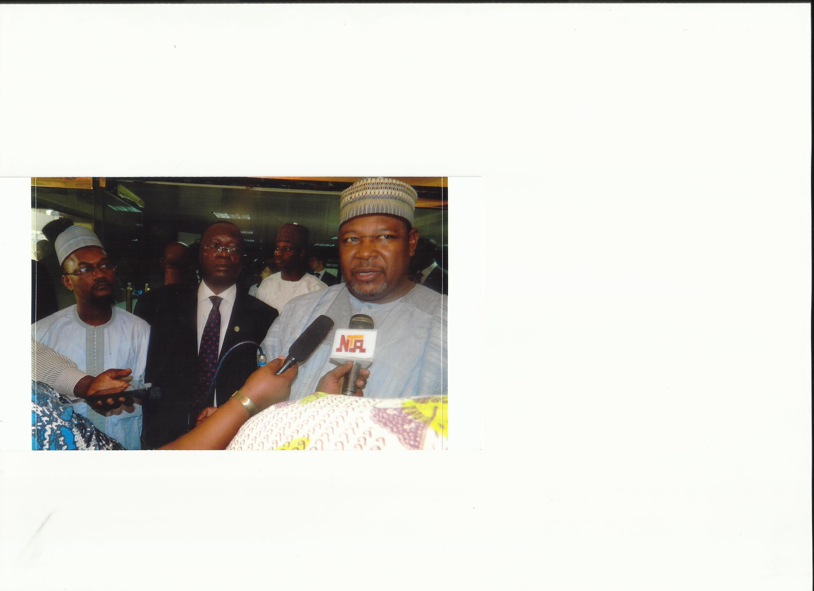
Successful Developments..
Nigeria’s Minister of Finance Launches Takaful
Operations from 2013
SI
Nigeria’s Minister of Finance Launches Takaful Operations from 2013
Nigeria has great potentials for Takaful Insurance considering its large population and Muslim community coupled with the fact that Takaful is for all irrespective of faith. Already Two Operators have been Licensed this year.

Slide 12
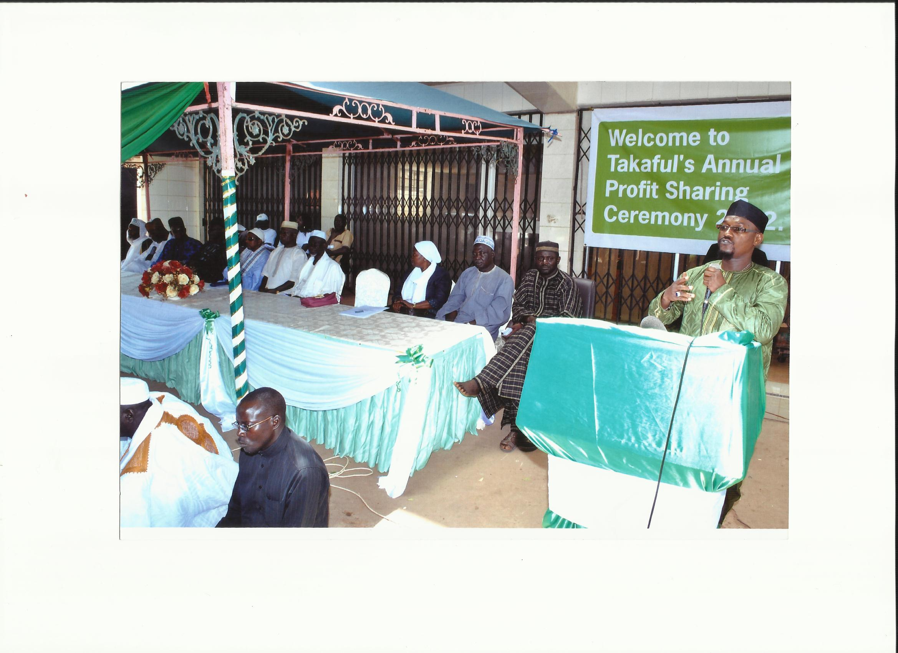
Successful Developments..
Nigeria’s Minister of Finance Launches Takaful
Operations from 2013
TGL Annual Profit Sharing
From 2009, TGL has annually distributed profits to participants.
Micro Takaful has great potentials in Gambia following the success story of Takaful Gambia Limited

Slide 13
Successful Developments..
Takaful Insurance of Africa in Kenya continuous to do well
Phoenix of Zambia’s Takaful Window is doing well
We have Zep-Re Takaful Window in Sudan providing Re-Takaful and Training
Africa Re-providing Re-Takaful from Egypt……

Slide 14
Takaful Potentials In Africa
Large Muslim Population: Population is a driver of growth
With the large Muslim population spread across Africa, Takaful has great growth potentials.
The increasing consciousness of Muslims to use financial product that are Shariah compliant.
The 2007/2008 economic crunch showcased the resilient nature of Islamic finance.
Value proposition embedded in surplus sharing

Slide 15
RESOLUTION!!!
Takaful is a blessing for African with the African Hospitality and culture of “CARING AND SHARING”
TAKAFUL – THE BEST AND MOST SUITABLE SYSTEM OF INSURANCE FOR AFRICA
Notes:
>>OUT>>LONG LIVE JESSICA AND YOUR ORGANIZING TEAM. THE PRESENTATION TOPICS COULDN’T HAVE COME AT A BETTER TIME. CONGRATULATIONS!!!

Slide 16
MICRO TAKAFUL !!!
Micro-insurance defined:
“Generally, micro-insurance is viewed just like other normal insurance on small scale for low-income people”
MicroTakaful redefined:
“A mechanism to provide Shariah-based protection to the blue collared, under-privileged individuals at an affordable cost”.

Slide 17
MICROTAKAFUL CONT’D…….
MicroTakaful can help needy people improve their livelihood
Microtakaful will help them sustain their financial well being.
Feeling of togetherness & security.
Opens avenues for joint efforts for mutual benefits.
Cooperative approach and outlook.
Result oriented
Society benefits at large.

Slide 18
Basic Elements of Takaful
MICROTAKAFUL CONT’D…….
Mutuality and cooperation.
Takaful contract pertains to Tabarru’at as against mu’awadat in case of conventional insurance.
Payments made with the intention of Tabarru (contribution)
Eliminates the elements of Gharrar, Maisir and Riba.
Wakalah/Modarabah basis of operations.
Joint Guarantee / Indemnity amongst participants – shared responsibility.
Constitution of separate “Participants’ Takaful Fund”.
Constitution of “Shariah Supervisory Board.”
Investments as per Shariah.

Slide 19
MICROTAKAFUL CONT’D…….
Participants Contribution
Participants
Pool of Contributions

Slide 20
MICROTAKAFUL CONT’D…….
The Takaful Advantage
Share Holder
S H A R E H O L D E R S’ F U N D (S.H.F.)
Wakalah Fee
Investment
Income
Mudarib’s Share of PTF’s Investment Income
Management Expense of
the Company
Profit/Loss
Takaful Operator
Investment by
the Company
WAQF
Operational Cost of Takaful / ReTakaful
Investment
Income
Claims &
Reserves
Surplus (Balance)
Participant
P A R T I C I P A N T S’ T A K A F U L F U N D
(P.T.F.)

Slide 21

MICROTAKAFUL CONT’D…….
Participants Contribution
Investment in
Shariah Complaint Securities
Participants
Profit from Investment
(Part of the profit goes to the
Company for acting as mudarib)
Pool of Contributions
Wakala Fee
Claims
Re-Takaful Expense etc.

Slide 22
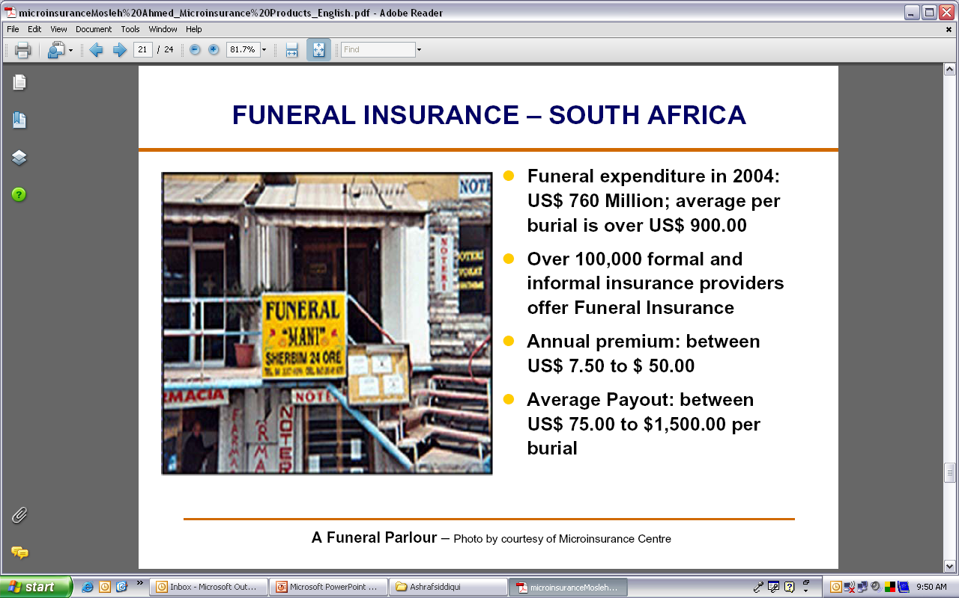
MICROTAKAFUL CONT’D…….

Slide 23
Types of MicroTakaful Products
Property
Fire
Rainfall
Floods
Theft
Agriculture
Prices
Health
Hospitalisation
Disability
Surgical
Out-patient
Permanent
Partial
Total
Temporary
Optical
Dread Disease
Dismemberment
Credit Disability
Life Insurance
Dental
“Transition funds”
Pensions
Credit Life
Funeral
Endowments
Education Life

Slide 24
السلام عليكم ورحمة الله وبركاته
Thank You
Shukran
Jere jef Sereign Touba
Questions & Answers

